Slide 1

NUMEROLOGY
NAME: AARAV MAHAJAN
CLASS : 10TH B
ROLL NO. : ”1”
SUBMITTED TO: ASHIMA ma`am

Slide 2
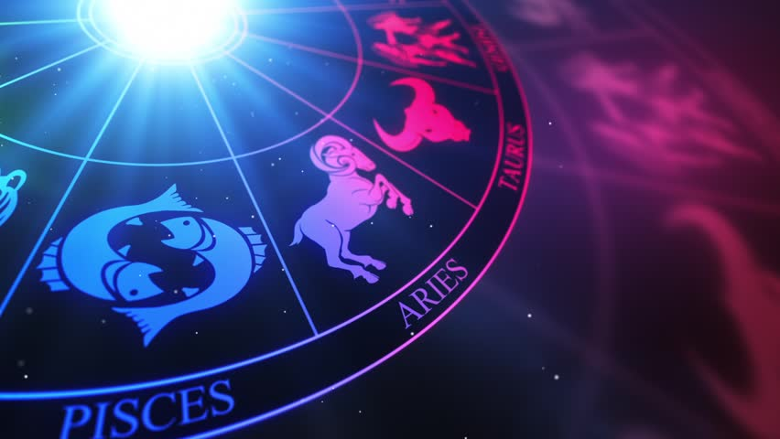
Table of Contents
Introduction
Table of contents
What is “NUMEROLOGY”?
The history numerology
Lack of evidence
How does numerology works?
What a numerology reading involves?
Methods
Chinese numerology
Indian numerology
Other uses of the term
In popular culture
Uses of numerology in Movies/TV shows
7 interesting facts about numerology
References
Thank you!!

Slide 3


What is “NUMEROLOGY” ?
In simple terms, numerology is a study of numbers in your life. You can uncover information about the world and also each individual person by using Numerology. Numerology is seen as a universal language of numbers.
If you are familiar with Astrology, then you may know a little bit about
Numerology; it is similar in quite a few ways but uses a different method to get the information and insight: Numbers.
Numerology is the idea that the universe is a system and once broken down we are left with the basic elements, which is numbers. These numbers can then be used to help us to better understand the world and ourselves as individuals.

Slide 4

The History Of Numerology:
Where numerology came from and how it came to be is somewhat of a mystery, like many ancient philosophies. Egypt and Babylon are where the earliest written records of numerology are said to be.
Other evidence shows that numerology was used thousands of years ago in Rome, China, Greece, and Japan.
Modern-day numerology is normally credited to Pythagoras, who was a Greek philosopher. Although it is not known if he invented Numerology, he had some theories behind it, which took numbers to a completely different level. These theories are now the reason behind Pythagoras having the credit for modern day numerology.
Dr. Julian Stenton was actually the person who came up with the name ‘Numerology’. He also bought recognition and awareness to it in modern day times. There is not much else known about the whereabouts of Numerology, it has become quite popular in today’s society and is used by many.

Slide 5
Lack Of Evidence:
Skeptics argue that numbers have no occult significance and cannot by themselves influence a person's life. Skeptics therefore regard numerology as a superstition and a pseudoscience that uses numbers to give the subject a veneer of scientific authority.^{[2]}
At least two studies have investigated numerological claims, both producing negative results: one in the UK in 1993,^{[11]} and one in 2012 in Israel^{[12]}. The UK experiment involved 96 people and found no correlation between the number seven and a self-reported psychic ability. The experiment in Israel involved a professional numerologist and 200 participants, and was designed to examine the validity of a numerological diagnosis of learning disabilities, like dyslexia and ADHD, and autism. The experiment was repeated twice and still produced negative results.

Slide 6
HOW DOES THE NUMEROLOGY WORKS?:
How numerology works is actually quite complicated and usually requires a master numerologist to provide detailed and accurate readings. Though you can easily find your life path number and things like your expression, personality, and soul urge numbers using basic calculations, it is the way that these numbers work together that need to be interpreted properly.
The idea behind numerology is that the cosmos and your life is affected by your birth date, birth name and many other factors surrounding an individual. In this way, there are great depths that a numerology forecastcan provide. Consequently, it can provide often astounding insights about somebody.
It is believed that there are no coincidences in the Universe that your name and birthday affect the journey that you will take and your characteristics, in the same way, that some look at horoscopes or astrology to interpret signs or destinies.

Slide 7
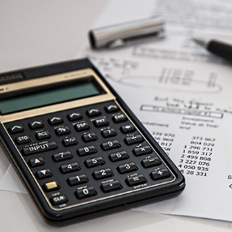
What A Numerology Reading Involves?
A numerology reading involves a lot of calculations. These calculations can go into many layers of depth with different numbers and combinations of numbers carrying various meanings. Even a basic reading based on your core numbers can be quite revealing. However, in the same manner that numbers are infinite, someone's numerology chart can continue to be read from many perspectives as an ongoing project.
Getting a numerology reading is actually quite fun and very interesting.
This is a great introduction for beginners, and it is also suited for those who want a deeper reading. Starting with your name and date of birth, they explain how your free numerology chart will not only tell you about yourself but help to provide direction in your life and wellbeing using a combination of your Life Path Number, Birthday Number, Soul Urge Number, Expression Number, and Personality Number.

Slide 8
Methods
Alphabetic systems: There are various numerology systems which assign numerical value to the letters of an alphabet. Examples include the Abjad numerals in Arabic, the Hebrew numerals, Armenian numerals, and Greek numerals. The practice within Jewish tradition of assigning mystical meaning to words based on their numerical values, and on connections between words of equal value, is known as gematria.
Latin alphabet systems: There are various systems of numerology that use the Latin alphabet. Different methods of interpretation exist, including Chaldean, Pythagorean, Hebraic, Helyn Hitchcock's method, Phonetic, Japanese, Arabic and Indian.
Pythagorean system: This method can be referred to as either Western Numerology or Pythagorean Numerology. The Greek Philosopher, Pythagoras, is known as the father of Western Numerology. Pythagoras began his theory of numbers by discovering the numerical relationship between numbers and musical notes. He found that the vibrations in stringed instruments could be mathematically explained.^{[13][14]} The Pythagorean method uses an individual’s name and date of birth. The name number reveals the individual’s outer nature. This is the personality that they present to the outside world. To start, you need to use the individual’s full name as written on their birth certificate. Then, each letter is assigned to a number one to nine, based on the ancient Pythagorean system.

Slide 9
Methods
The numbers are assigned to letters of the Latin alphabet as follows:
1 = a, j, s,
2 = b, k, t,
3 = c, l, u,
4 = d, m, v,
5 = e, n, w,
6 = f, o, x,
7 = g, p, y,
8 = h, q, z,
9 = i, r,
Next, add together all of the numbers associated for each letter in your full birth name. Then, the number is reduced until you obtain a single number.
Example: James Duncan Halpert
James
1+1+4+5+1
= 12
Duncan
4+3+5+3+1+5
= 21

Slide 10
Methods
Halpert
8+1+3+7+5+9+2
= 35
James Duncan Halpert
12+21+35
= 68
6+8
= 14
1+4
= 5
Then, Jim Duncan Halpert’s name number is 5.
A quicker way to arrive at a single-digit summation (the digital root) is simply to take the value modulo 9, substituting a 0 result with 9 itself. As mentioned before, the single digit then arrived at is assigned a particular significance according to the method used.

Slide 11
Methods
When someone changes their name they will get a new name number. This is believed to change certain parts of the individual’s personality and destiny. Next, the birth number is viewed as an extension of the name number. This number represents the traits/talents that you desire to have. It is believed that your birth number reveals your inner nature and life purpose. To find your birth number you add together all the numbers in the month, day, and year you were born. Then, you reduce that number to a single digit number.
Example:
James’ birthday is May 5th, 1997
5+5+1+9+9+7
= 36
= 3+6
= 9
In the Pythagorean system, there are three master numbers (11, 22, 33) which do not get reduced to a single number. Hence, if your name number or birth number comes out to one of these master numbers, then you do not combine the numbers to form a single digit. Finally, the single digit name number and birth number are assigned a particular meaning and significance based on the Pythagorean system.

Slide 12
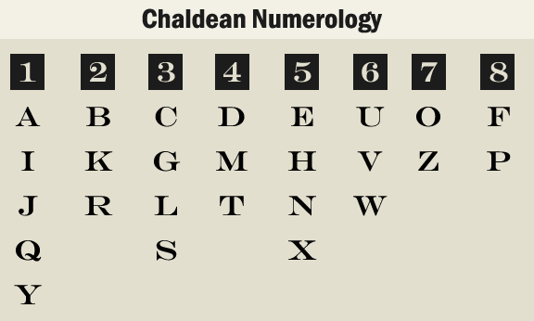
Methods
Chaldean system:
The Chaldeans were ancient people who ruled Babylonia from 625–539 BC. Therefore, this system is also known as the Babylonian numerology system. Chaldean numerology is used to recognize the energy changes that occur when you or someone else speaks or thinks. The sound of someone speaking comes out in vibrations of different frequencies that affect the speaker and those around them. The Chaldean system uses the numbers 1-8. The number 9 is not used in the system because it is regarded as sacred due to its connection to infinity. The Chaldean system uses this 1-8 number system on the name that the individual is currently using because that is the energy that would currently be projected. Then, each letter is assigned to a number one to eight, based on the Chaldean numerology chart

Slide 13
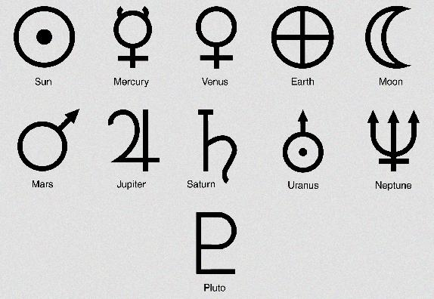
Methods
The numbers are assigned to letters of the Latin alphabet as follows:
1 = a, q, y, i, j
2 = b, r, k
3 = g, c, l, s
4 = d, m, t
5 = e, h, n, x
6 = u, v, w
7 = o, z
8 = f, p
Example: Assume James Duncan Halpert normally goes by Jim.
Jim
1+1+4
= 6
Duncan
4+6+5+3+1+5
= 24
= 2+4
= 6
Chaldean Numerology Vowels

Slide 14
Methods
Halpert
5+1+3+8+5+2+4
= 28
= 2+8
= 10
= 1+0
= 1
Then, Jim Duncan Halpert’s name numbers are 6, 6, and 1.
The Chaldean system recognizes the same master numbers that were present in the Pythagorean system. These master numbers are 11, 22, and 33. The master numbers do not get reduced to single digits. In the Chaldean system, an individual’s first name is their social persona and how they present themselves in public and the energy that comes with that. The first name also indicates the individual’s personal interests and habits. The middle name is the soul energy and it reveals the truth about your inner soul and the deepest parts of yourself. The middle name shows the hidden talents, desires, and what your soul is trying to reach for. The last name is related to the domestic influence of the family.

Slide 15
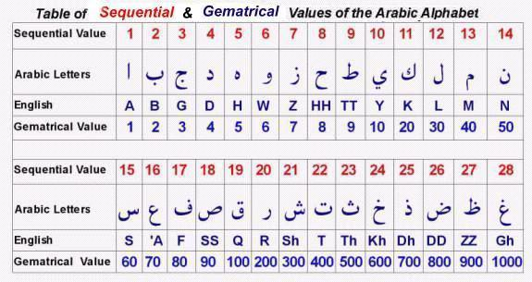
Methods
Abjad system:
The Arabic system of numerology is known as Abjad notation or Abjad numerals. In this system each letter of Arabic alphabet has a numerical value. This system is the foundation of ilm-ul-cipher, the Science of Cipher, and ilm-ul-huroof, the Science of Alphabet:
ط=9 ح=8 ز=7 و=6 ه=5 د=4 ج=3 ب=2 أ=1
ص=90 ف=80 ع=70 س=60 ن=50 م=40 ل=30 ك=20 ي=10
ظ=900 ض=800 ذ=700 خ=600 ث=500 ت=400 ش=300 ر=200 ق=100
غ=1000

Slide 16
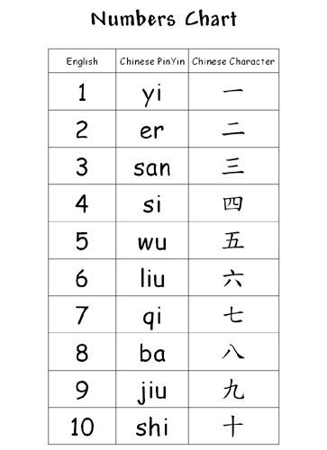
Chinese numerology
Some Chinese assign a different set of meanings to the numbers and certain number combinations are considered luckier than others. In general, even numbers are considered lucky, since it is believed that good luck comes in pairs.
Traditional Chinese Medicine (TCM), and its associated fields such as acupuncture, base their system on mystical numerical associations, such as the “12 vessels circulating blood and air corresponding to the 12 rivers flowing toward the Central Kingdom; and 365 parts of the body, one for each day of the year” being the basis of locating acupuncture points.

Slide 17
Chinese numerology
Chinese number definitions:
Cantonese frequently associate numbers with the following connotations (based on its sound), which may differ in other varieties of Chinese:
一 [jɐ́t] – sure
2. 二 [jiː̭] – easy 易 [jiː̭] Abjad system Chinese numerology Chinese number definitions
3. 三 [sáːm] – live 生 [sáːŋ] but it can also be seen as a halved eight when using Arabic numerals (3) (8) and so considered unlucky.
4. 四 [sēi] – considered unlucky since 4 is a homophone with the word for death or suffering 死 [sěi], yet only in the Shanghainese, it is a homophone of water (水) and is considered lucky because water is associated with money.
5. 五 [ŋ̬ ] – the self, me, myself 吾 [ŋ̭ ], nothing, never 唔 [ŋ, m] in the Shanghainese, it is a homophone of fish (鱼)
6. 六 [lùːk] – easy and smooth, all the way
7. 七 [tsʰɐ́t] – a slang/vulgar word in Cantonese.
8. 八 [pāːt] – sudden fortune, prosperity 發 [fāːt]
9. 九 [kɐǔ ] – long in time 久 [kɐ̌u], enough 夠 [kɐ̄u] or a slang/vulgar word derived from dog 狗 [kɐ̌u] in Cantonese

Slide 18

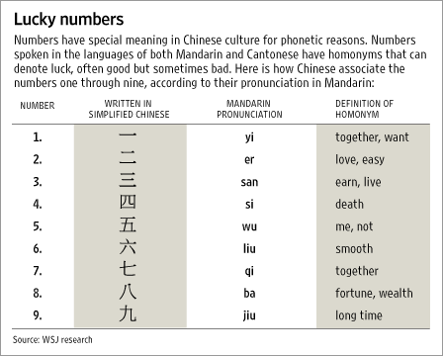
Chinese numerology
Some "lucky number" combinations include:
99 – doubly long in time, hence eternal; used in the name of a popular Chinese American supermarket chain, 99 Ranch Market.
168 – many premium-pay telephone numbers in China begin with this number, which is considered lucky. It is also the name of a motel chain in China (Motel 168).
888 – Three times the prosperity, means "wealthy wealthy wealthy“

Slide 19

Indian numerology
Indian numerology is also known as Vedic numerology because it emerged in the era of the Vedas, some of the oldest and most sacred texts of the Indo-Aryans. Most of the Vedic period (except the earlier phase of Rig-Veda) occurred from the 12th to 6th century BC, making this system of numerology more or less contemporary to Chaldean and Chinese systems of numerology.
Vedic numerology works on the principle of numbers’ vibratory resonance. When one’s action and the vibration of the individual’s number are in harmony, resonance is created. A person’s number works well when resonance occurs.

Slide 20
Indian numerology
Every numerology system has its own specialty, such as the Chaldean system’s compound numbers. Indian Vedic numerology is based on the idea that everything in this material word is influenced by one or more of the nine planets.
Vedic astrology considers the moon to be the most important factor for analysing an individual’s inner self, the mind, and the soul.
The list is shown below:
1 = A, I, J, Q, Y
2 = B, K, R
3 = C, G, L, S
4 = D, M, T
5 = E, H, N, X
6 = U, V, W
7 = O, Z
8 = F, P
There is no assignment for the number “9”.
Numerologists analyze double-digit numbers from 10 to 99.

Slide 21
Other uses of the term.
Subcarrier Spacing and Symbol Length in 5G/NR Wireless Communication Systems:
Fifth generation (5G), a.k.a. New Radio (NR), uses the term "numerology" to describe the combination of subcarrier spacing and symbol length. For example, in NR(5G) several different numerology (i.e., different subcarrier spacing and symbol length) are supported whearas in LTE there is only one numerology.
To describe questionable concepts based on possibly coincidental numerical patterns
Scientific theories are sometimes labeled "numerology" if their primary inspiration appears to be a set of patterns rather than scientific observations. This colloquial use of the term is quite common within the scientific community and it is mostly used to dismiss a theory as questionable science.

Slide 22
Other uses of the term.
The best known example of "numerology" in science involves the coincidental resemblance of certain large numbers that intrigued such eminent men as mathematical physicist Paul Dirac, mathematician Hermann Weyl and astronomer Arthur Stanley Eddington. These numerical coincidences refer to such quantities as the ratio of the age of the universe to the atomic unit of time, the number of electrons in the universe, and the difference in strengths between gravity and the electric force for the electron and proton. ("Is the Universe Fine Tuned for Us?", Stenger, V.J.,
The discovery of atomic triads, an early attempt to sort the elements into some logical order by their physical properties, was once considered a form of numerology, and yet ultimately led to the construction of the periodic table. Here the atomic weight of the lightest element and the heaviest are summed, and averaged, and the average is found to be very close to that of the intermediate weight element. This didn't work with every triplet in the same group, but worked often enough to allow later workers to create generalizations. Large number co-incidences continue to fascinate many mathematical physicists. For instance, James G. Gilson has constructed a "Quantum Theory of Gravity" based loosely on Dirac's large number hypothesis

Slide 23
Other uses of the term.
Large number co-incidences continue to fascinate many mathematical physicists. For instance, James G. Gilson has constructed a "Quantum Theory of Gravity" based loosely on Dirac's large number hypothesis. [21] Wolfgang Pauli was also fascinated by the appearance of certain numbers, including 137, in physics. [22] British mathematician I. J. Good wrote: There have been a few examples of numerology that have led to theories that transformed society: see the mention of Kirchhoff and Balmer in Good (1962, p. 316) ... and one can well include Kepler on account of his third law. It would be fair enough to say that numerology was the origin of the theories of electromagnetism, quantum mechanics, gravitation.... So I intend no disparagement when I describe a formula as numerological. When a numerological formula is proposed, then we may ask whether it is correct. ... I think an appropriate definition of correctness is that the formula has a good explanation, in a Platonic sense, that is, the explanation could be based on a good theory that is not yet known but ‘exists’ in the universe of possible reasonable ideas. — I. J. Good

Slide 24
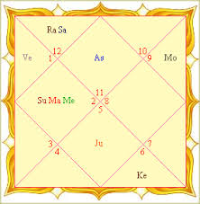
Other uses of the term.
Attempts by gamblers to see patterns in random chance:
Some players apply methods that are sometimes called numerological in games which involve numbers but no skill, such as bingo, roulette, keno, or lotteries. Although no strategy can be applied to increase odds in such games, players may employ "lucky numbers" to find what they think will help them. There is no evidence that any such "numerological strategy" yields a better outcome than pure chance, but the methods are sometimes encouraged, e.g. by casino owners.
PLAYING AT “CASINO” WITH THE USE OF NUMEROLOGY

Slide 25
In popular culture:
Numerology is a popular plot device in fiction. Sometimes it is a casual element used for comic effect, such as in an episode titled "The Séance" of the 1950s TV sitcom I Love Lucy, where Lucy dabbles in numerology. Sometimes it is a central motif of the storyline, such as the movie π, in which the protagonist meets a numerologist searching for hidden numerical patterns in the Torah; the TV show Touch which focuses almost entirely on the role of numerology in the events and coincidences of any person's life; and the movie The Number 23, based on claimed mysteries of the number 23 (itself based on the Law of Fives). Numerology is a topic taught in Arithmancy class in the Harry Potter series of books. In Harry Potter and the Prisoner of Azkaban, the third book of the series, Arithmancy is offered as an elective course. In Harry Potter’s world, arithmancy was used as the practice of assigning numerical value to words in order to predict the future .

Slide 26


USE OF NUMEROLOGY IN MOVIES/TV SHOWS:
Use of “NUMEROLOGY” in the movie
“SUPER 8”
This is the front cover art for the book Harry Potter and the Prisoner of Azkaban written by J. K. Rowling. The book cover art copyright is believed to belong to the publisher, Bloomsbury (UK) (Canada 2010–present), or the cover artist, Cliff Wright (UK Edition).

Slide 27
7 Interesting Facts About Numerology
Fact 1: Positive And Negative Numbers:
All numbers used in numerology include both positive and negative features that should be recognized. Though numbers have a balance of positive and negative throughout their whole self, it is important to know that numbers are influenced by many factors. This includes your outlook and other numbers that are correlated with your different life aspects, such as career, business, health, and love.
A true, in-depth numerology forecast will not simply focus on the positives and will consider the impact of negative numbers in your chart in order to give you the best understanding of yourself. This is where numerology is used to help people focus their lives for the better.

Slide 28
7 Interesting Facts About Numerology:
Fact 2: Master Numbers In Numerology:
Master numbers in numerology are 11, 22 or 33. They have deep and powerful meanings. The true meanings can be good or bad depending on the context. Therefore, it is important to interpret master numbers properly. Mostly they should be used for guidance or revelation of certain circumstances that impact somebody's life in a way that needs to be addressed.
Typically, the methods used during a numerology reading mean that double-digit numbers found in date of births (birthday numbers) are usually split apart and added together to leave a single digit number that becomes a part of the calculation. But when the result of a calculation equates to a master number, it is not reduced and will carry its own meaning.
Master number 11 can relate to “instinct” and “faith”. Similarly, it could signify fear and anxiety, so has to be carefully read.
Number 22 is the Master Builder. It is the most powerful indicator of ambition and success, though often requires guidance or different perspectives.
The number 33 has various meanings as one of your core numbers i.e. Life Path, Expression, Personality etc. Not forgetting that all of these master numbers can be combined to form entirely different meanings in partnership with others, or as a triangle of enlightenment!

Slide 29
7 Interesting Facts About Numerology:
Fact 3: Using Numbers As A Guide For Life:
Numerology in its fullest form is much more than a reading or insight into who you are as a person. In fact, many followers and advocates of numerology include highly successful celebrities that attribute their careers to numerology. The science of numerology tells you what your barriers are. Plus, it can give you a direction based on your position in the universe, potentially attributing to this success.
Deep and powerful feelings that many initially find hard to comprehend become apparent, it can inspire people to change their direction completely and begin to treat numerology as a forecast for life.
Fact 4: Converting To Numerology:
Numerologists often report that once people take the step to look further into their numerology chart, they are so taken with the revelations of some of their core desires and issues in life that they will often continue on their path of discovery and enlightenment. Once you discover the accuracy of numerology readings, you can discover the truth yourself. Plus, learn what those inner feelings have been trying to tell you all of your life.

Slide 30
7 Interesting Facts About Numerology:
Fact 5: Strengths And Weaknesses For Purpose:
Because of the accuracy of reading and insights they reveal, friends and others that have taken numerology readings will often encourage others to look into numerology as a way to find their true strengths and weaknesses. Through this discovery alone you can give yourself a better idea of what you should and shouldn’t be doing in your life. Furthermore, this could give you greater purpose to move forward.
Fact 6: So Many Numbers And Meanings:
Though there are calculators and online tools to work out your individual core numbers, it is important for people to understand that there are so many numbers and meanings behind combinations of numbers and your individual self that you need a proper numerologist to interpret these for you. Where a birthday calculator can give you that one number and its meaning can show you certain basic principles behind your character, your life path number gives that factor a different meaning or viewpoint. This is where numerology is much more insightful than horoscopes and other spiritual based methods used in a similar way.

Slide 31
7 Interesting Facts About Numerology:
Fact 7: Numerology From Birth
One of the most fascinating aspects of numerology is that the readings are all based around the time you entered the universe in your human form. From your birth. So whether you like your name or not, or when your birthday sits in the year, all of it has a meaning.
If it were known at your time of birth and your parents were numerologists, then effectively you would never have had to consider who you are and what you should be doing in life to make you happy, or important in the world. So be proud of your full name and whenever your birthday may fall! Numerology, and its factors suggests everything about the reason you are here at all. And it’s never too late to find out.

Slide 32
REFERENCES:
WEBSITES:
Wikipedia
The law of attraction
Numerology
Learn about numerology
Ganesha speaks
Tarot reading
BOOKS:
Cheiro's Book of Numbers
The Life You Were Born to Live (Book by Dan Millman)
Numerology: With Tantra, Ayurveda, and Astrology (Book by Harish Johari)

Slide 33

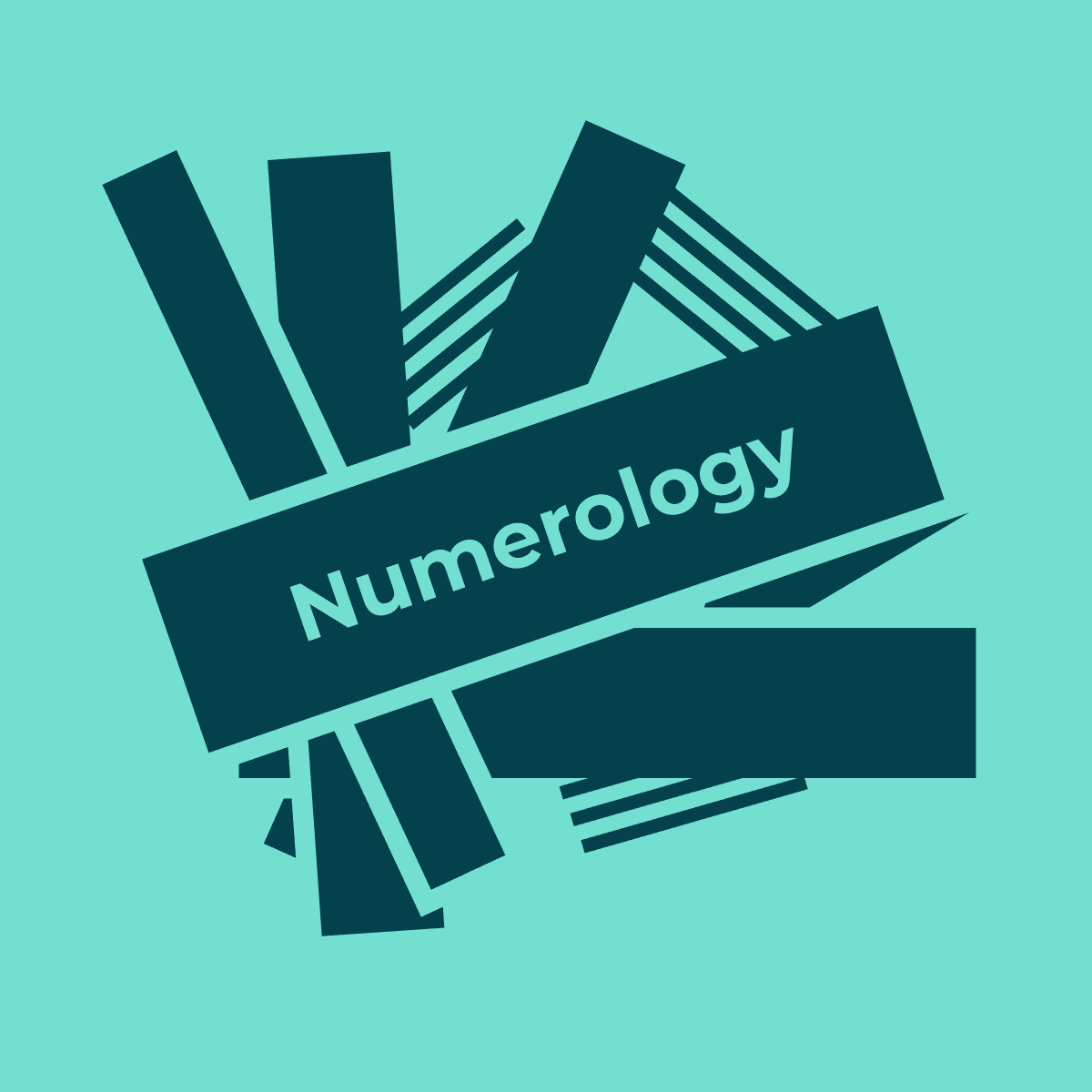
DROP YOUR QUERIES AT:
EMAIL: AARAVMAHAJAN2003@GMAIL.COM

